Slide 1
Machine Learning Capstone
Build a Personalized Online Course Recommender System with Machine Learning
María Belén Camandone 07-2024

Slide 2

Outline
Introduction and Background
Exploratory Data Analysis
Content-based Recommender System using Unsupervised Learning
Collaborative-filtering based Recommender System using Supervised learning
Conclusion
Appendix

Slide 3
Introduction
Project background and context
In the contemporary digital era, online learning has gained immense popularity due to its flexibility, accessibility, and the wide range of courses available. However, the vast amount of content can overwhelm learners, making it challenging for them to identify courses that align with their interests and goals. This necessitates the development of personalized online course recommender systems, which can suggest relevant courses to users based on their preferences and past behavior.
This project focuses on building a personalized online course recommender system using various machine learning algorithms. The project is structured into several modules, each employing a different recommendation method.

Slide 4
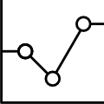
Exploratory Data Analysis

Slide 5
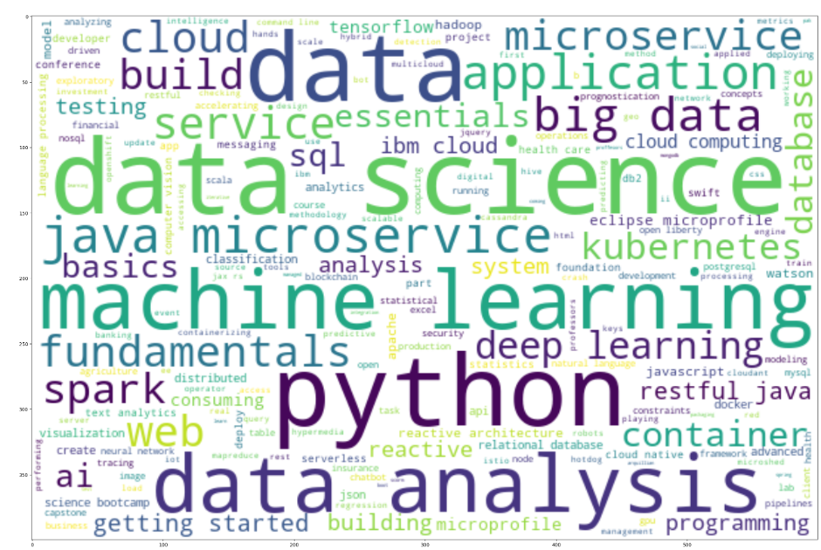
Word cloud of course titles
A word cloud is a graphical representation of text data where the size of each word indicates its frequency or importance within the dataset.
For this project, the word cloud was generated using the titles of all available courses. The most prominent words, such as "data," "science," "machine," and "learning," suggest that courses related to data science and machine learning are highly prevalent. By looking at these keywords, we should have a general understanding that the courses in the dataset are focused on demanding IT skills.

Slide 6
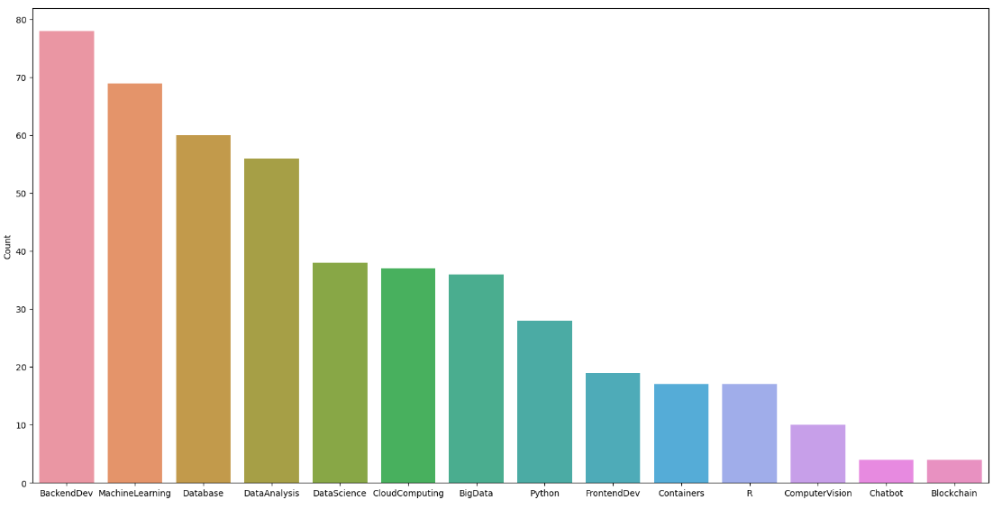
Course counts per genre
The bar chart illustrates the distribution of course offerings across various genres. The x-axis represents different course genres, while the y-axis indicates the number of courses available in each genre.
The distribution of courses by genre reveals a strong emphasis on backend development, machine learning, and data-related skills. This aligns with current industry trends where these skills are in high demand. Understanding this distribution helps in tailoring the recommendation system to prioritize popular and essential genres, thereby enhancing the relevance and value of course recommendations for users.

Slide 7
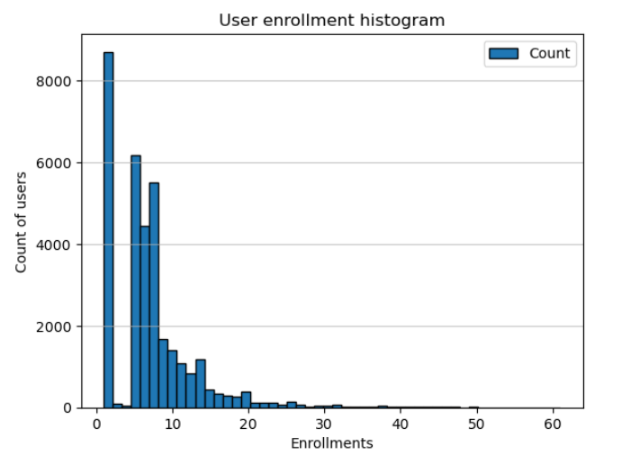
Course enrollment distribution
This histogram illustrates the distribution of user enrollments across various courses. The x-axis represents the number of enrollments per user, while the y-axis shows the count of users with a given number of enrollments.
The median is 6 courses, and the largest number of users enroll in a single course.
The distribution shows a long tail, indicating that while the majority of users enroll in a small number of courses, there are outliers who enroll in a significantly higher number of courses.
Understanding this distribution helps in personalizing recommendations to cater to the diverse engagement levels of users.

Slide 8
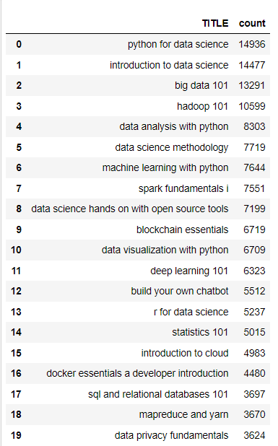
20 most popular courses
The distribution of enrollments among these top 20 courses underscores the prominence of data science and related fields such as machine learning, big data, and programming. Courses focusing on practical skills and cutting-edge technologies tend to attract more enrollments, reflecting the current trends and demands in the industry. This information is vital for developing a recommendation system that aligns with user interests and industry needs.

Slide 9
Content-based Recommender System using Unsupervised Learning
Cluster2
Cluster1

Slide 10
Flowchart of content-based recommender system using user profile and course genres
The most common type of content-based recommendation system suggests items to users based on their individual profiles. A user's profile encapsulates their preferences and tastes, which are inferred from their interactions, such as the frequency of clicks or the items they have liked.
The recommendation process hinges on the similarity between items. This similarity is determined by comparing the content features of the items, such as category, tags, genre, and other attributes. In essence, the system analyzes these features to find items that closely match the user's profile.
Load data
Data processing
Define score threshold
Apply the generate recommendationscores function

Slide 11
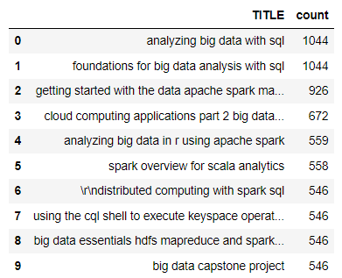
Evaluation results of user profile-based recommender system
I chose a threshold score of 60, and I only keep the results with scores larger than the recommendation threshold.
On average, 12 new/unseen courses have been recommended per user (in the test user dataset).
The top-10 commonly recommended courses are:

Slide 12
Flowchart of content-based recommender system using course similarity
In these recommendations we use the course similarity matrix to identify and recommend new courses that are similar to the ones in which users are already enrolled.
Load data
Data processing
Define score threshold
Apply the generate recommendationscores function

Slide 13
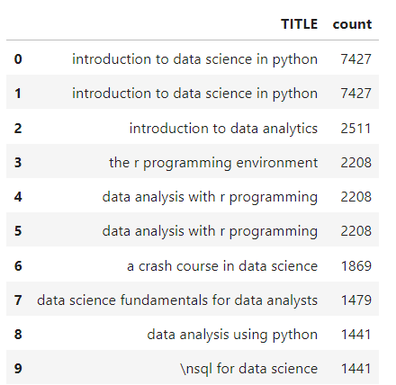
Evaluation results of course similarity based recommender system
I chose a threshold score of 55, and I only keep the results with scores larger than the recommendation threshold.
On average, 2 new/unseen courses have been recommended per user (in the test user dataset).
The top-10 commonly recommended courses are:

Slide 14
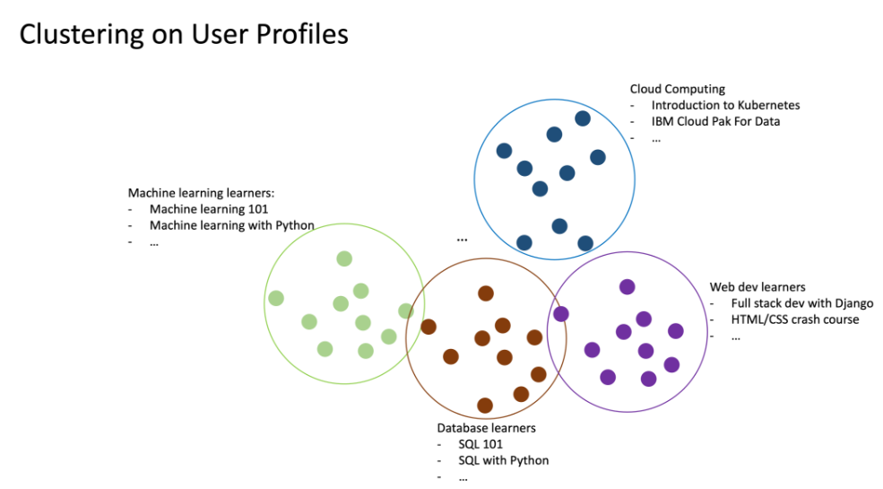
Flowchart of clustering-based recommender system
We can apply clustering algorithms such as K-means or DBSCAN to group users based on their similar learning interests.
Then, generate course recommendations based on the popular courses in the same cluster.
Load data
Data processing
Apply PCA
Define the number of clusters by Elbow Method
Apply KMeans

Slide 15
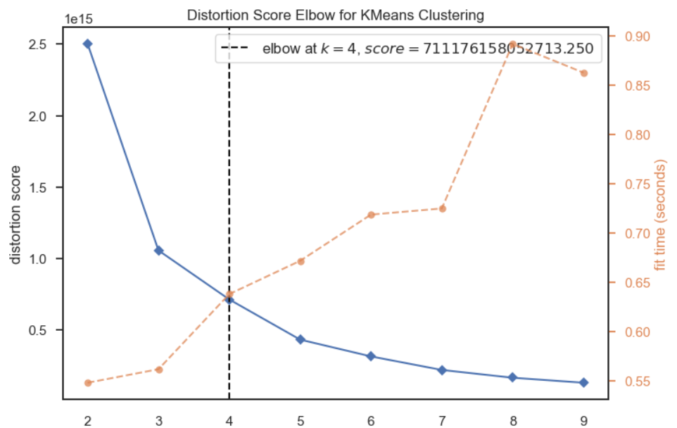
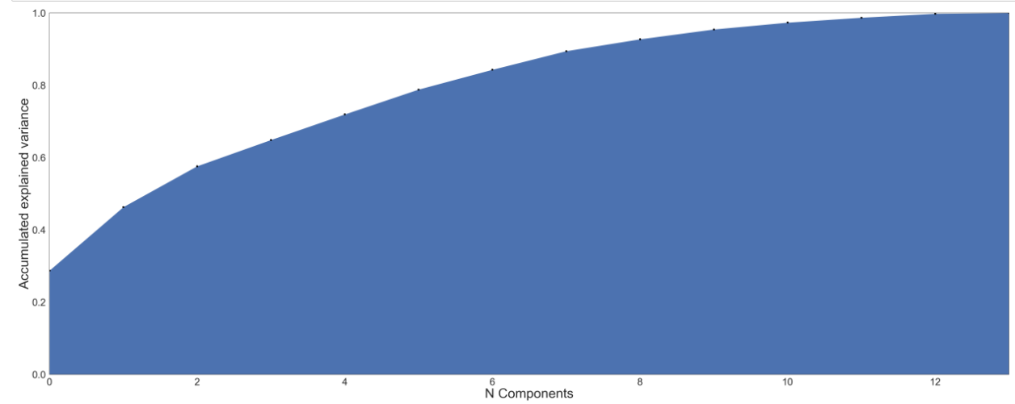
Evaluation results of clustering-based recommender system
Keep 90% of explained variance, apply Elbow Method, grouping in 4 clusters:

Slide 16
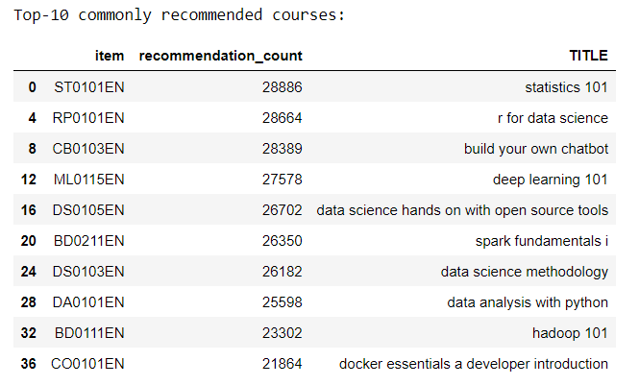
Evaluation results of clustering-based recommender system
On average, 15 new/unseen courses have been recommended per user (in the test user dataset)
The top-10 commonly recommended courses are:

Slide 17
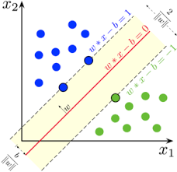
Collaborative-filtering Recommender System using Supervised Learning

Slide 18
Flowchart of KNN based recommender system
Collaborative filtering is a technique that leverages user interactions and preferences to make recommendations. It is based on the idea that if two users have had similar preferences in the past, they are likely to continue to have similar tastes in the future. This approach can be divided into two main categories:
- User-based: collaborative filtering is based on the user similarity or neighborhood
- Item-based: collaborative filtering is based on similarity among items
In this project, I used the Surprise library and the KNN algorithm with item-based collaborative filtering. To calculate the similarities, I chose the cosine and Pearson correlation metrics.
Load data
Data processing
KNN by surprise library

Slide 19
Flowchart of NMF based recommender system
Non-negative matrix factorization (NMF) decomposes a big sparse matrix into two smaller and dense matrices.
Non-negative matrix factorization can be one solution to big matrix issues. The main idea is to decompose the big and sparse user-interaction into two smaller dense matrices, one represents the transformed user features and another represents the transformed item features.
Load data
Data processing
NMF by surprise library

Slide 20
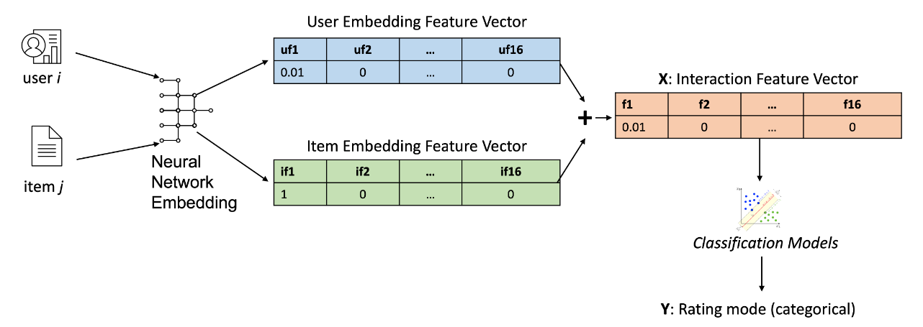
Flowchart of Neural Network Embedding based recommender system
Built models to predict numerical course ratings using the embedding feature vectors extracted from neural networks.
Load data
Data processing
Apply classification algorithms

Slide 21
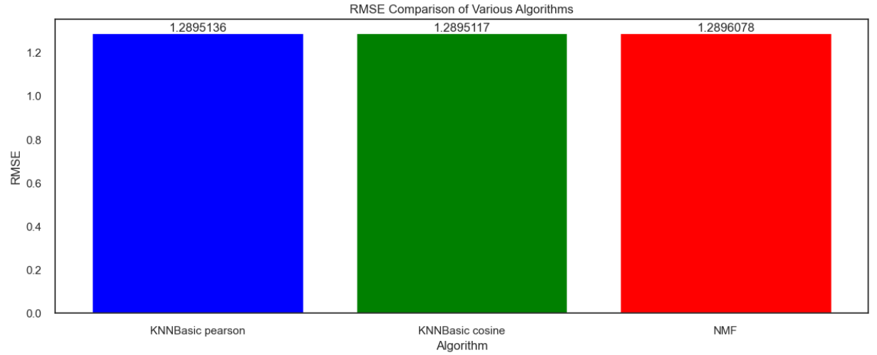
Compare the performance of collaborative-filtering models (KNN,NMF)
Based on the results presented in the bar graph, we can draw the following conclusions about the performance of the three algorithms (KNNBasic with Pearson similarity, KNNBasic with Cosine similarity, and NMF:
Algorithm Selection: Since all three algorithms produced similar values of RMSE, the choice among them may depend on other factors such as computational efficiency and interpretability.
Parameter Tuning: The similar RMSE values suggest that further tuning of the parameters for each algorithm might be necessary to potentially uncover differences in performance.
Dataset Characteristics: The specific characteristics of the dataset might have influenced the similar performance outcomes. It might be beneficial to analyze if certain inherent properties of the dataset (e.g., sparsity, distribution of ratings) contribute to this result.

Slide 22
Compare the performance of collaborative-filtering models using the embedding feature vectors
For this case, using the embedding feature vectors extracted from neural networks to predict numerical course ratings with a regression linear model it is not a viable option.
Linear regression is designed for continuous target variables, where the outcome can take any value within a range. Our target variable in this dataset is discrete, with only a few possible outcomes (3, 4, or 5), so, linear regression is not appropriate because can produce predictions that are not valid ratings. For example, it might predict a rating of 3.7 or 4.2.
We also consider the prediction problem as a classification problem also using embedding features.
We tested with Logistic Regression and Xgboost models but they both had a low overall accuracy around (33%) , indicating that they are not performing well in classifying the instances into the three classes.

Slide 23
In this project, we developed a personalized online course recommendation system using various machine learning techniques. The main objectives were to enhance user experience by providing course recommendations that align with their interests and past behaviors.
Specifically, we developed:
Content-based recommendation systems:
Using user profiles and course genres.
Based on course similarity.
Using user profile clustering with PCA and K-means.
Collaborative filtering systems:
Based on KNN (K-Nearest Neighbors).
Using NMF (Non-negative Matrix Factorization).
Using the embedding feature vectors
Conclusions

Slide 24
Conclusions
Limitations:
Limited Hyperparameter Optimization: Due to hardware constraints, we were unable to perform extensive hyperparameter optimization. This limitation may have affected the performance and accuracy of some models.
Results:
The content-based models are easy to interpret, but, can have a high computational cost if the dataset is large. However, applying PCA and K-means proved to be an efficient and quick strategy for clustering user profiles.
The collaborative filtering algorithms, implemented through the Surprise libraries, were simple and fast to apply. These methods provided efficient recommendations.
On the other hand, using the embedding feature vectors extracted from neural networks and then apply linear regression was not possible in this case, a target variable consisting of discrete ratings (3, 4, or 5) is not appropriate due to the continuous nature of linear regression predictions. Furthermore, the classification models not performing well in classifying the instances into the three classes.

Slide 25
Conclusions
Future Research Directions:
Impact:
The implementation of these recommendation systems has great potential to improve user experience on online learning platforms, making it easier for users to find courses that best fit their needs and interests. This not only increases user satisfaction but can also enhance student retention and engagement on educational platforms.
Exploring other hyperparameters: Conducting more comprehensive hyperparameter optimization using grid search, random search, or Bayesian optimization methods to enhance model performance.

Slide 26

Appendix
Complete code:
Final project : Recommender System - Part 1: https://bit.ly/3WpD2ob
Final project : Recommender System - Part 2: https://bit.ly/3SqHyBy

